Slide 1
Professional Development
Career Progression and the Feedback it Takes to Grow Leaders
MSgt Corey Bayne
89 MXG/MXMA
Joint Base Andrews, MD
04 May 2018
Notes:
Introduction; if anyone has to use the restroom, please do so as quietly as you can as we go along.

Slide 2
Professional Development
Topics
Feedback Process
Bullet Writing
Mentorship
Deliberate Development
Board Process
Enlisted Performance Reports (EPRs)
Decorations Process
Weighted Airman Promotions System (WAPS)
Whole Airman Concept
Notes:
Topics to cover

Slide 3
Professional Development
What does the board care about?
Why is this so stressful?
What do I need to make on the test to pass?
Which direction should I take this impact?
Where to start?
What does ‘Whole Airman Concept’ mean?
What will get me and my subordinates promoted?
What did I do eight months ago?
How do I build strong bullets?
Notes:
The intent of today’s presentation is to explain the importance of feedback, the preparation necessary to build the ‘Whole Airman Concept’, and debunk some misnomers about career progression to ensure the right emphasis is being placed on the right priorities.

Slide 4
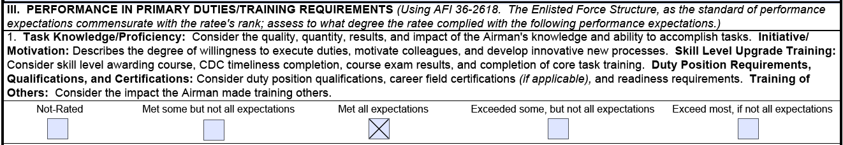
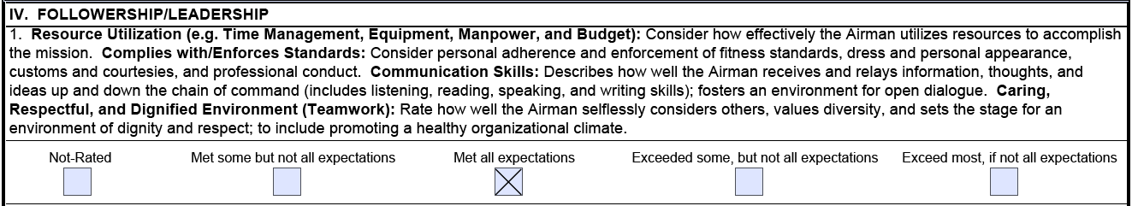
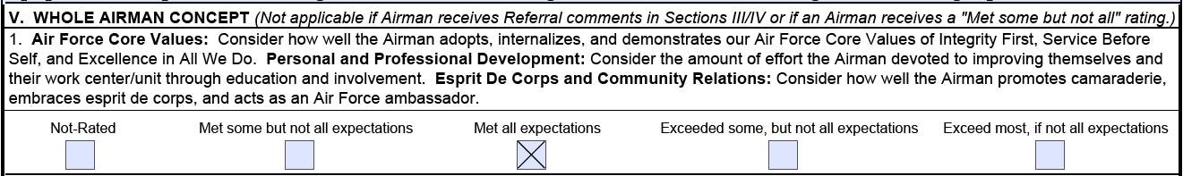
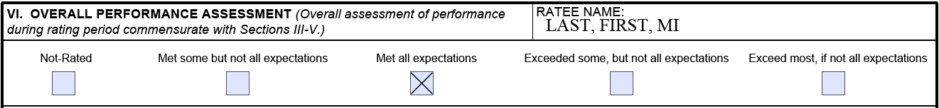
Professional Development
I thought for sure I was going to be far right in every category?! What happened?
Notes:
Let me start by asking a question… ”How many of you have been faced with this scenario?” (PAUSE)… “What was it that made us think that we deserved to be far right in every category?” (Debunk “entitlement” mindset) “How could we have known ahead of time whether we were exceeding expectations or not?”

Slide 5
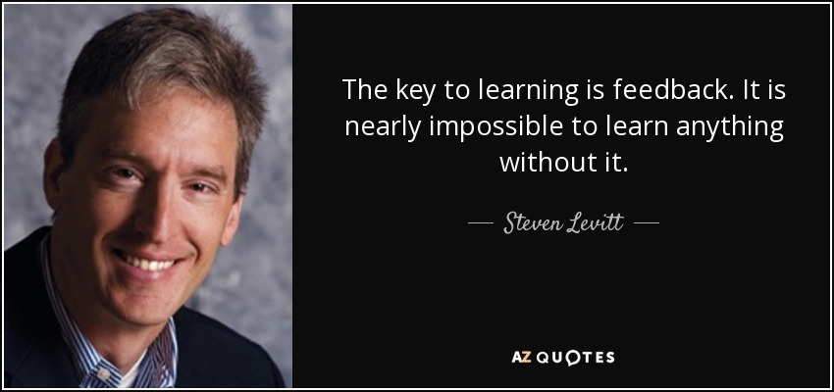
Feedback Process
Notes:
American Economist, Steven Levitt

Slide 6
Feedback Process
Supervisors
Set clear, attainable, and appropriate expectations during every ACA feedback
Provide continuous feedback; immediately correcting departures of standards as well as praising exceptional performance
Get to really know your subordinates and treat them as the leaders you want them to become; help them to see their potential
Notes:
Where do you see your subordinates one year from now? What about five years from now? What about ten? If you envision them in a leadership position, who helped get them there?

Slide 7
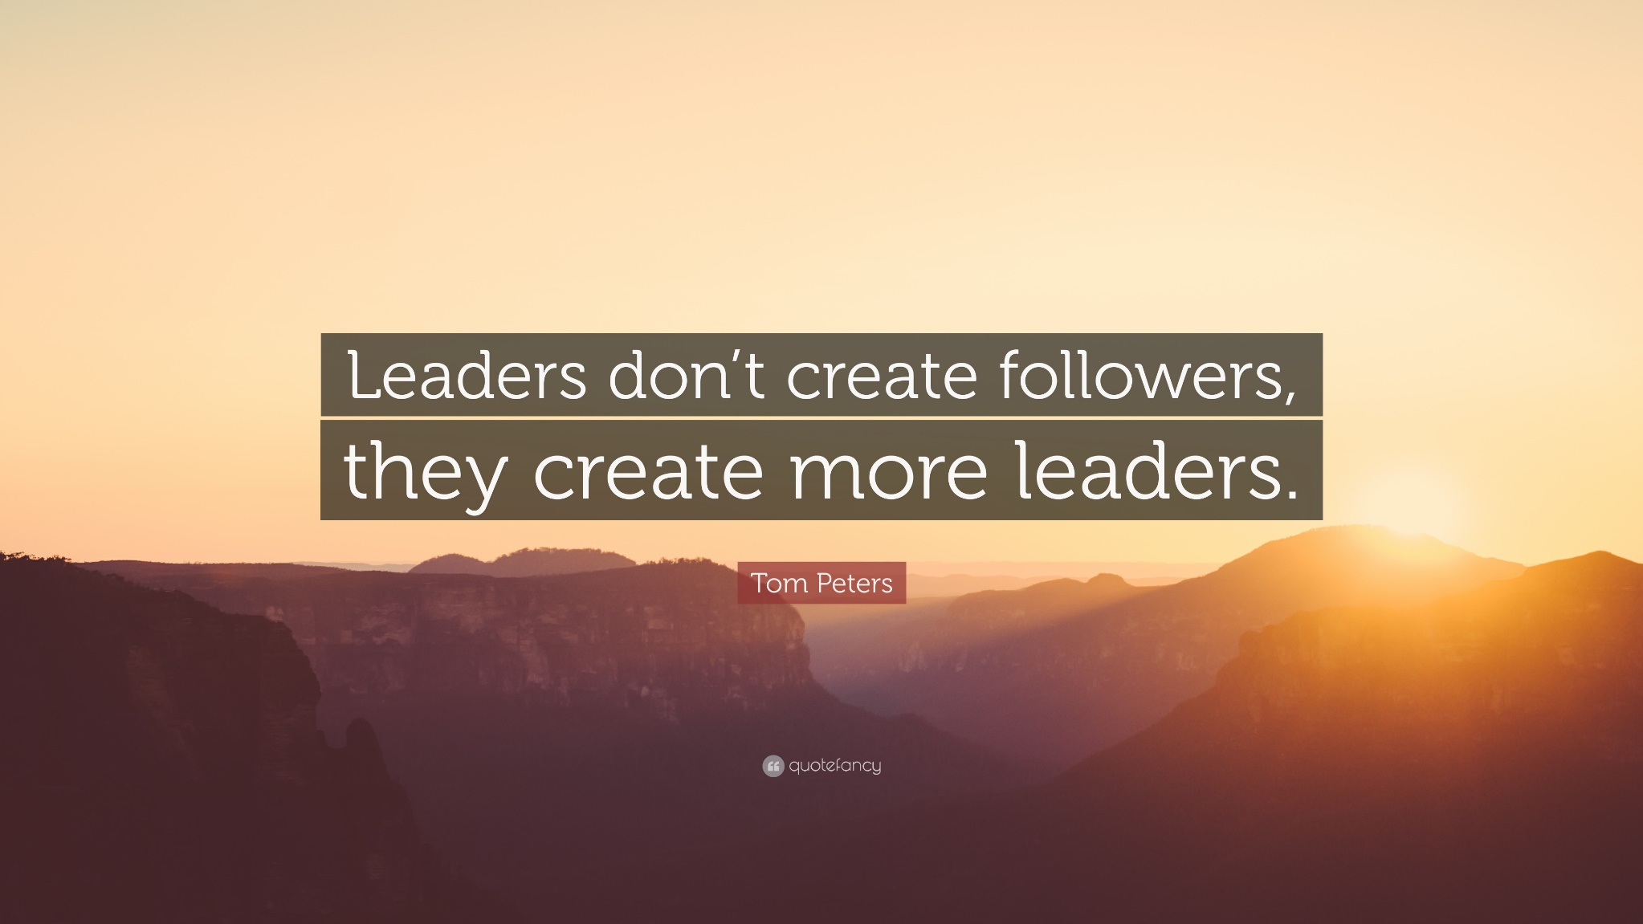
Feedback Process
Notes:
American writer on business management practices, Tom Peters. It’s not just supervisors that have a part in the feedback process either…

Slide 8
Feedback Process
Subordinates
Share your goals, aspirations, interests, and intentions with your supervisors honestly
Share with your supervisor what ways work best for you to achieve desired outcomes
Understand that you and your supervisor are a team working toward a common goal
Understand that daily habits determine the success of achieving the goals you have set

Slide 9
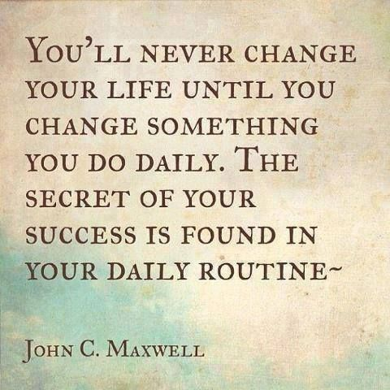
Feedback Process
Notes:
American writer, pastor, and renowned leadership speaker, Dr. John Maxwell. // One of easiest daily habits we could change now to benefit our careers in the future is by capturing information about bullets more often and as close to the event as possible. We’ll talk more about that in the upcoming slides.

Slide 10
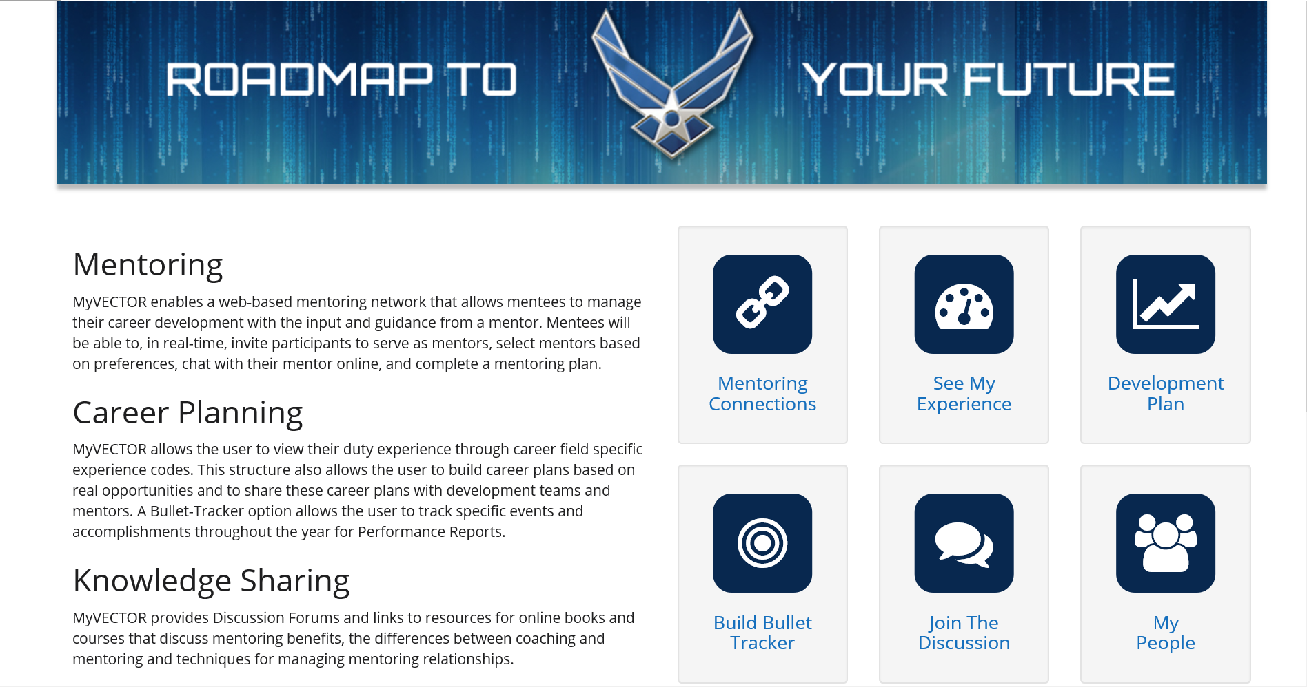
Bullet Writing

Slide 11
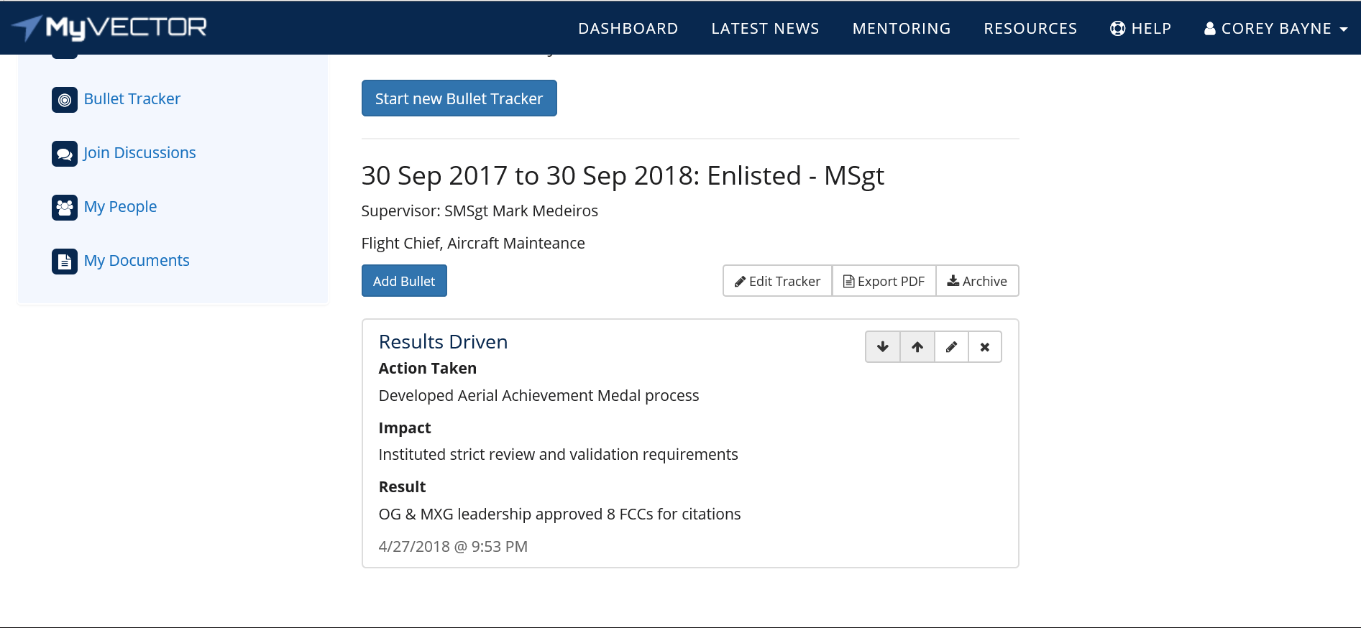
Bullet Writing
Pointer
Notes:
The intent here is simply placing all of the information surrounding an event into its appropriate category; formal bullet structure could be accomplished later.
(NEXT SLIDE SET-UP): I have another question for everyone… “Who in here considers themselves a great bullet writer?”

Slide 12
Bullet Writing
Pointers
Record as much information about the accomplishment as soon as practical to the event
Use a standardized way to record bullets. MyVector is a great tool, however, use what works best for you and your supervisor
Get into the habit of writing complete bullets every month or every quarter for practice
Take or teach bullet writing courses yourself
Take the initiative to no longer be a “bad bullet writer”.
Notes:
If no bullet writing opportunities exist, create one.

Slide 13
Mentorship

Slide 14
MyVector Mentor Expectations
Key to the mentoring process is the direct involvement of the commander and supervisor in the professional development of his or her people. Airmen have the option of selecting mentors. Some of the expectations of mentors are:
Share relevant knowledge, experience, and resources with mentees
Identify & resolve potential issues of mentees
Encourage mentees to improve occupational & institutional competencies (AF Portal > Career and Training > Force Development > AF Competencies)
Support mentee’s career planning and goal setting
Offer guidance, provide feedback, and acknowledge accomplishment
Facilitate opportunity for new experiences and skill building
Provide wise counsel
Listen to personal & professional challenges of mentees
Notes:
Highlight a few key bullets to emphasize the supervisor’s (mentor’s) role

Slide 15
MyVector Mentee Expectations
Mentees are expected to become actively involved in their learning and developmental needs. They are encouraged to develop a mentoring plan that clearly identify the developmental goals to be accomplished. Some mentee expectations are:
Development of a career roadmap by identifying and clarifying current & future goals
In-depth understanding of the mission, goals, and political structure of the Air Force
Enhancement of technical skills
Endowed with more responsibility to take ownership of learning and developmental needs
Identification of leadership strengths and areas for improvement via an on-line assessment tool
Opportunity to expand leadership abilities
Enhanced opportunities for career advancement
Notes:
Highlight a few key bullets to emphasize the subordinate’s (mentee’s) role

Slide 16
Deliberate Development
Supervisors
Seek out opportunities in the areas you know your subordinates need developing
Seek out growth opportunities that align with your subordinate’s interests and/or with their potential; shaping their ‘Whole Airman’ experience
Continuously follow-up with your subordinate’s progress toward meeting their ACA stated goals each reporting period
Notes:
DEVELOPMENT: “Have your subordinates performed any community involvement or led any events?”
TALENT & SKILL: “Are your subordinates extremely talented at something in particular that the unit, Wing, or Air Force could benefit from?”
As supervisors, it is our responsibility to recognize the path our Airmen are currently on, the one they should be on, and what it takes to guide them in the right direction

Slide 17
Deliberate Development
Subordinates
Seek out opportunities in the areas you know you need developing and discuss this with your supervisors
Seek out growth opportunities that align with your own interests and/or potential; shaping your ‘Whole Airman’ experience
Continuously follow-up with your supervisor as you progress toward your ACA stated goals each reporting period
Notes:
You must take stock in your own careers and discuss your interests with your supervisors. The decisions you make today impact your career intentions of the future.

Slide 18
Strategic Planning
Supervisor
“What can I do now to become successful in the future?”
Subordinate

Slide 19
Promotion Board Process
Supervisor Preparation
Make sure each subordinate’s DVB and PRDA records are accurate WELL BEFORE their PECD/file freeze date
Discuss with your subordinates when their board is scheduled or projected to convene
Discuss the following slide’s performance factors with subordinates and explain how each contribute to their development…
Notes:
Understand what’s important… We shouldn’t concern ourselves with the board process itself… our focus should be the deliberate development of our Airman who, in turn, have records that reflect the achievements the board looks for when deciding whether or not they’re ready for the increased responsibility.

Slide 20
Promotion Board Process
(Example Only)
Factors: Board Evaluates:
Duty Performance EPRs / Training Records
Professional Competence Expertise in Specialty
Leadership Supervisor / Staff / etc.
Job Responsibilities Scope / Exposure
Breadth of Experience Where / What / When
Specific Achievements Awards / Decs / EPRs
Education Level / Utilization
------------ POTENTIAL ------------
Notes:
It is worth noting that not every board is the same and factors may differ slightly from one to the other. A great resource to gauge what an upcoming board’s priorities might be is to reference the previous year’s Formal Board Charge, which can be found on myPers under the Promotions section.

Slide 21
Performance Reports
Preparing for EPRs
Supervisors must take the time early on to guide subordinates toward new experiences in order to offer deliberate development
When appropriate, tie significant actions and impacts to results that deal with recognition (i.e. quarterly award, MAJCOM nom, etc.)
Future roles highlight subordinate’s realistic leadership potential. NOTE: Boards notice if one role is listed or if roles are unrealistic
Notes:
Avoid using future roles that: 1.) aren’t in line with realistic career progression, 2.) you know the subordinate is not ready for, 3.) or the role isn’t possible for them to attain
(i.e. listing Commander as a future role for an enlisted member or Flight Chief for a Staff Sergeant who has never supervised anyone)

Slide 22
Performance Reports
EPRs in vPC
Supervisors are responsible for confirming that the correct form is used, the information is accurate and matches the shell, and content is formatted correctly
Supervisors are responsible for keeping EPRs moving throughout the routing process
Once the EPR is ready for ratee signature, supervisors are responsible for conducting feedback concerning the EPR ratings, performance during previous reporting period, as well as new reporting period expectations
Final ratee signed EPRs must be sent to the 89 MXG/CSS either directly in vPC (if option is available) or via e-mail
Notes:
The end-of-reporting feedback should not come as a surprise to the subordinate if the feedback process itself was followed.

Slide 23
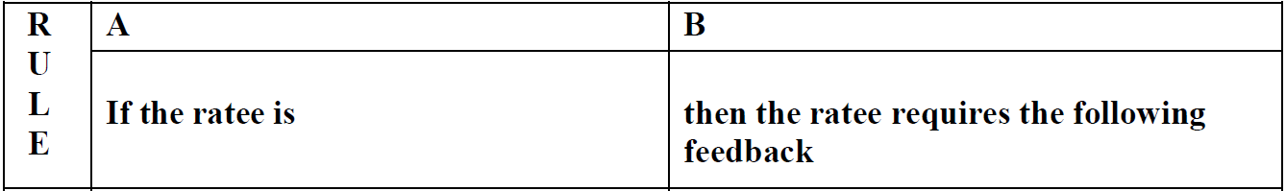
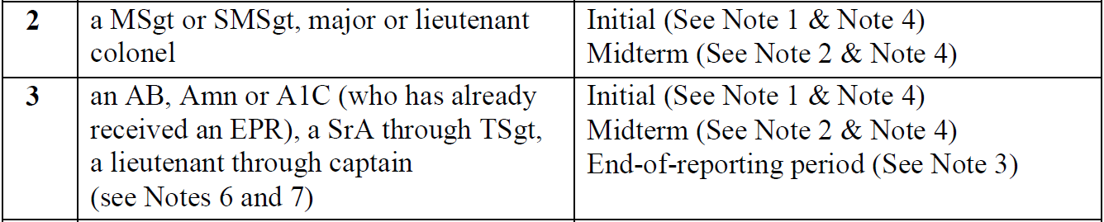
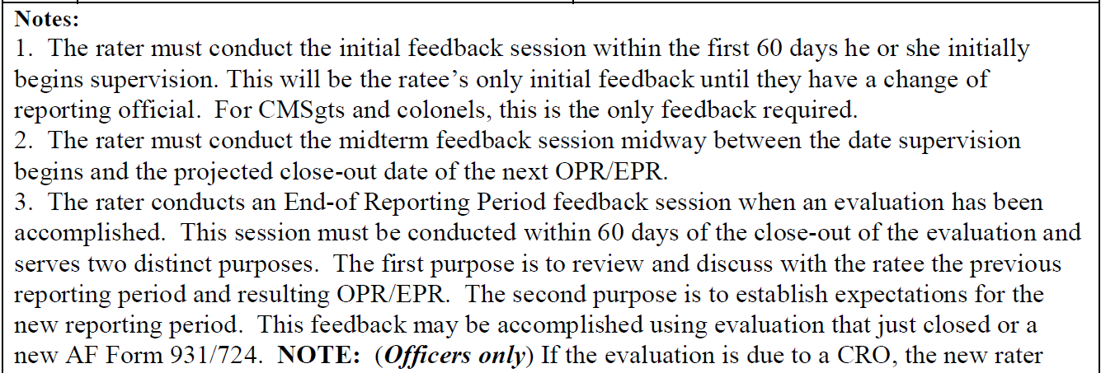
AFI 36-2406, Table 2.1
(For Reference Use Only)
End-of-Reporting Feedback FAQ
Does a new ACA feedback need to be completed after an EPR has been closed out and no change in ratee has occurred?
Notes:
Click to add notes

Slide 24
Decorations Process
Preparing Decorations
Decorations will be reviewed by performance boards long after EPRs will, therefore, leadership traits are highly encouraged to be included
Supervisors should consider seeking out two or three different types of accomplishments when preparing decoration citations to showcase ‘breadth of experience’
Avoid similar or same actions that are reflected in previous decoration citations awarded within the same performance period
Notes:
I have seen instances where the work wasn’t put in to ensure the same or similar actions weren’t already included in a previous decoration and that cannot happen. Do the research and thoroughly review all three EPRs AND previous decoration citations within the same performance period to avoid this incident.

Slide 25
Decorations Process
Decorations in vPC
Specific guidance concerning initiating a decoration in vPC can be found on the FCC Section SharePoint site under: FCC Section Programs > Awards and Decorations Guidance > 89 MXG Decorations Program
89 MXG/CSS personnel, supervisors, or section leadership may offer further assistance if necessary
AF Awards & Decs Regulation: AFI 36-2803

Slide 26
WAPS Promotion Testing
Subordinate Preparation
Work with your supervisor to develop a suitable study plan weeks in advance
Know where to find the most current study material (i.e. EPRRC, eWORLD, AFH-1, etc.)
Refer to most current version of AFI 36-2605 and familiarize yourself with acceptable and unacceptable study habits (i.e. group study) as well as how to prepare for military testing
Notes:
EPRRC (Enlisted Promotion References and Requirements Catalog), eWORLD (Electronic WAPS Online Reference Library Database), Air Force Handbook-1 (Found on e-Pubs)

Slide 27
Professional Development
FEEDBACK
BULLET
WRITING
PROMOTION
TESTING
DELIBERATE
DEVELOPMENT
MENTORSHIP
BOARD
PROCESS
Whole
Airman
Concept
DECORATION
PROCESS
EPR
PROCESS
Notes:
All of these categories combined help to make up the ‘Whole Airman Concept’

